Slide 1
Employee Data Analysis using Excel
STUDENT NAME: SUBASRI V S
REGISTER NO: 322200032
DEPARTMENT: B.COM HONOURS
COLLEGE: ANNA ADARSH COLLEGE FOR WOMEN

Slide 2
PROJECT TITLE
Employee Performance Analysis using Excel

Slide 3


AGENDA
Problem Statement
Project Overview
End Users
Our Solution and Proposition
Dataset Description
Modelling Approach
Results and Discussion
Conclusion
3/21/2024 Annual Review

Slide 4

PROBLEM STATEMENT
The main aim of this analysis is to identify the levels of performance of different classes of employees of an organisation;
Such an analysis provides scope for improvement, and helps to identify inefficiencies in operation, and thus optimises operational functions;
This is also useful in appraising the work of employees, by rewarding better workers and penalising those who don’t function efficiently;
This can also be utilised to identify areas wherein the workers/ employees are inefficient/ incompetent, and helps to optimise cost;
This shall be very beneficial for both the organisation as well as employees for the purpose of retrospective analysis;

Slide 5

PROJECT OVERVIEW
EMPLOYEE PERFORMANCE ANALYSIS shall refer to the evaluation of an employee , based on their work output, behaviour, skills to analyse whether they are fulfilling their job responsibilities;
This involves evaluating both qualitative as well as, quantitative data, which are, in turn, used to identify strengths, areas for improvement, and any gaps between expected and actual performance;
This assists in informed decision making, about bonuses, rewards, to ensure merit basis, and helps set up a common benchmark for all employees to work towards;
This also helps bring about a boost in the morale of employees, and induces productivity by identifying inefficiencies;

Slide 6

WHO ARE THE END USERS?
EMPLOYER ie. THE ORGANISATION: This analysis, is paid for and conducted by the employer for, identifying skill gaps, and manage talent development programmes. This is also used to analyse the amount of compensation to be given to the employees, and is also very much helpful in identifying potential leaders and key personnel for future leadership roles; Supervisors use data to recognize achievements and motivate their teams through rewards and recognition programs.
EMPLOYEES: Employees use performance data to understand their strengths, areas for improvement, and career progression opportunities. They rely on this analysis to seek feedback, set personal goals, and pursue learning and development opportunities.

Slide 7
WHO ARE THE END USERS?
OTHER ORGANISATIONS: This is used by other organisations for two main purposes, ie. To set their own benchmarks, with respect to operations and performance, and the second being, to recruit people from the organisations in which such analysis is undertaken;
SURVEY ORGANISATIONS: Survey organisations mainly use this data to arrive at an industry average, of the level of productivity in a certain sector or group of companies;
CONSULTANTS AND AUDITORS: Consultants use this data to provide strategic advice on improving organizational efficiency, culture, and employee engagement. External auditors may use employee data analysis to conduct performance audits, ensuring that organizational practices align with industry standards.

Slide 8

OUR SOLUTION AND ITS VALUE PROPOSITION
Conditional Formatting: To identify the missing values and remove the blank spaces, by shading the blank areas.
Filtering: To filter out or to remove the identified missing values, by utilising filter function.
Formulas: To convert employee rating points to employee performance levels by using functions IFS and TRUE.
Pivot Table: To summarize the required data by using a few datasets such as, Gender code, Performance levels, Business units and the First name.
Graphs: Pictorial representation of Data.

Slide 9
DATASET DESCRIPTION
Employee Dataset – Kaggle which contained 26 features, out of which only 9 features were taken into consideration. These features are as follows:
Employee ID number.
First name and Last name of the Employee.
Employment type.
Performance Level.
Employee Rating.
Gender.
Business Unit.
Performance scores.
Employee classification type.

Slide 10

THE "WOW" IN OUR SOLUTION
The unique, yet effective solution added to the data, was the simplification of the ratings given to each employee;
The ratings given, were on the basis of the productivity of the employee, ranged from 1-5;
By utilising Excel Functions, the same were converted into Performance Levels, ranging from, Very High, High, Medium and Low;
The formula used therein for the same is:
=IFS(Z2>=5,"VeryHigh",Z2>=4,"High",Z2>=3,"Medium",TRUE,"Low")}
3/21/2024 Annual Review
10

Slide 11
MODELLING
1. Data Collection:
Data can be collected from Kaggle or Edunet Dashboard.
2. Feature selection:
Identifying the required feature form the number of features available – 9 out of 26 features were selected.
3. Data cleaning:
Identification of missing values and filtering out the missing values.
4. Performance level Calculation:
Calculation of performance level from current employee rating in order to convert the numerical data into text form.
Calculation using
=IFS(Z2>=5,"Very High",Z2>=4,"High",Z2>=3,"Medium",TRUE,"Low")
11

Slide 12
MODELLING
5. Preparation of Pivot table:
Pivot table preparation using various factors out of the chosen 9 factors
namely, Name, Business unit, Gender and Performance level.
Pivot table:
Filters : Gender Code
Legend (Series): Performance Level
Axis (Categories): Business Unit
Values: Count of First Name
6. Preparation of Chart:
Preparation of chart (Clustered column charts) using the data from
Pivot table and naming it as Employee Performance Analysis Chart.
Adding a trend line to the most common Trend Level (Medium).
12

Slide 13
RESULTS
13

Slide 14
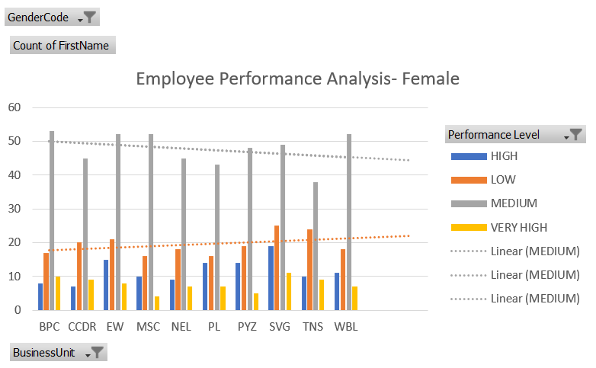
RESULTS
14

Slide 15
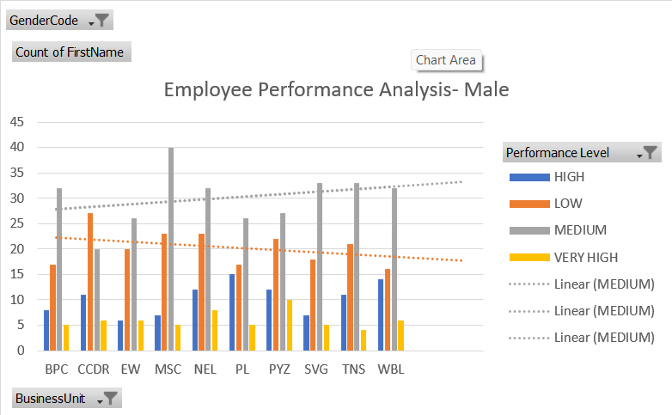
RESULTS
15

Slide 16
CONCLUSION
A number of conclusions can be drawn from the data given above;
Looking at the overall view, it can be interpreted that, in each department, the number of employees who have secured medium ratings are the highest in number;
This is followed by the number of employees, who have very low ratings;
The number of employees with high and very high ratings are less in number;
The trend lines in both males, as well as females is linear/ constant in nature, showing consistent numbers with respect to each category of performance;

Slide 17
SUGGESTIONS
Since the medium level performers are high in number, initiatives are to be taken to push them onto the next levels; This can be done effectively by using appraisal, appreciation and bonus based methods;
Low level performance, being the next highest in number, must be given attention and should be given a properly curated training, and if competent enough already, must undertake severe actions to ensure better performance by enforcing more stringent rules, ultimatums, etc.
By setting clearer goals, rewarding and recognizing employees, avoiding micromanagement, etc., productivity can thus be increased multifold amongst employees;

